Slide 1
Building Data base

Slide 2
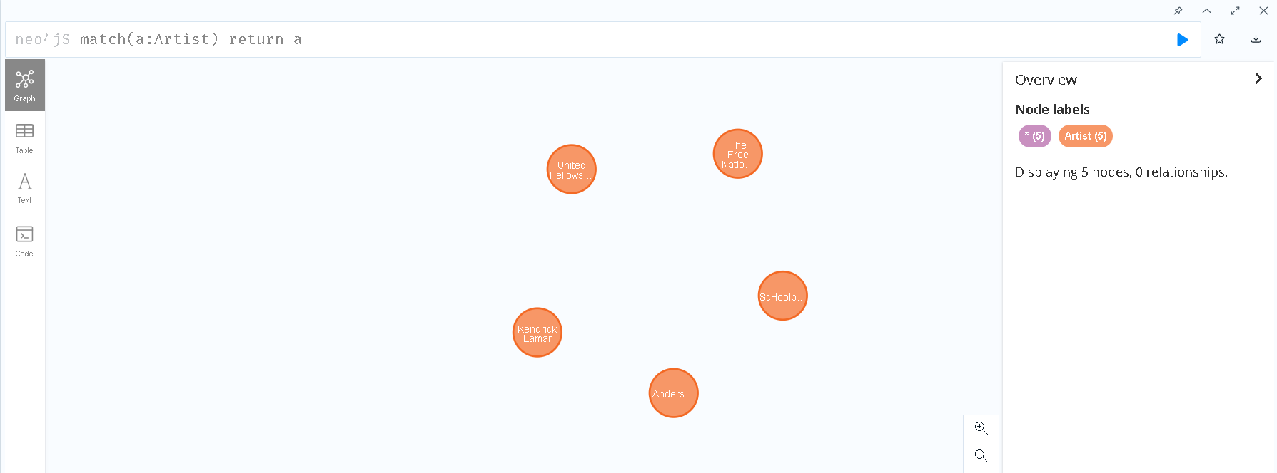
1. Create artists nodes
Example:
CALL apoc.load.json("bird.json") YIELD value create(t:Artist{name:value.Artist})

Slide 3
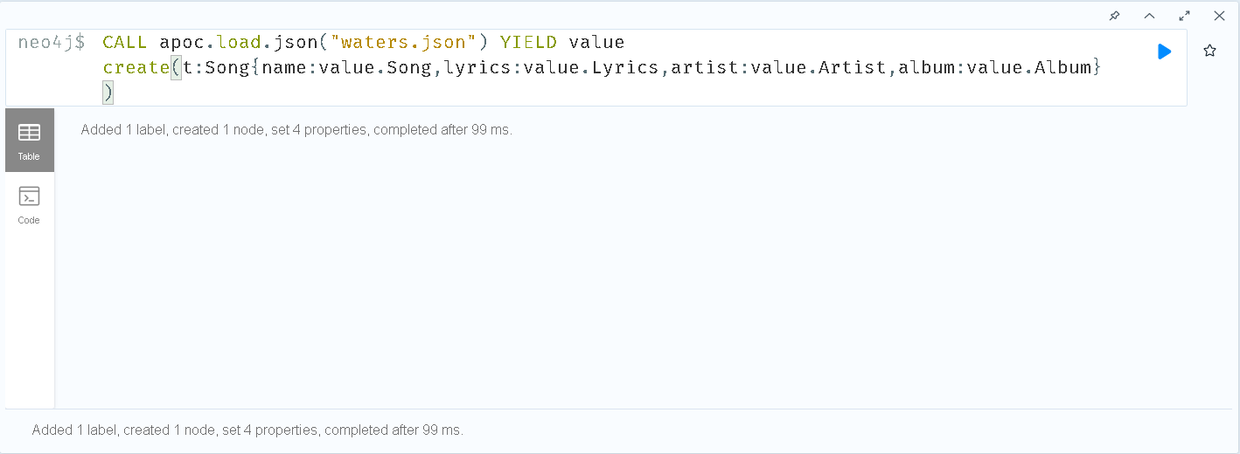
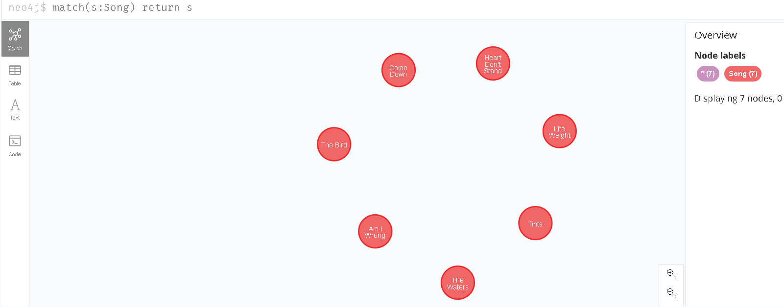
2. Create songs

Slide 4
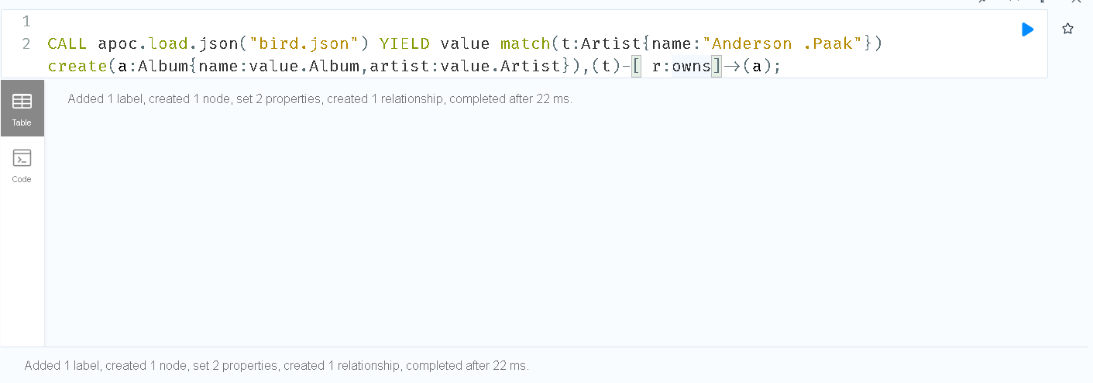
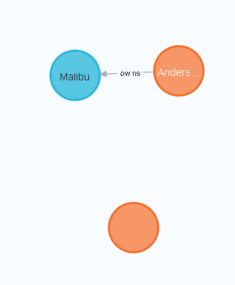
3. Create album and relation with artist

Slide 5
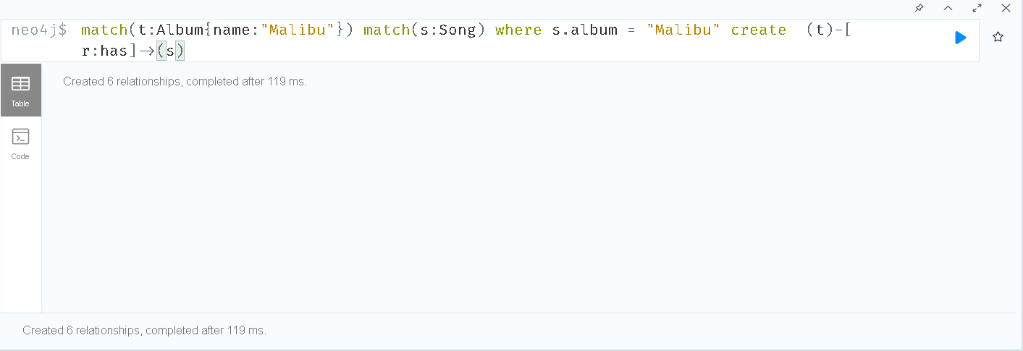
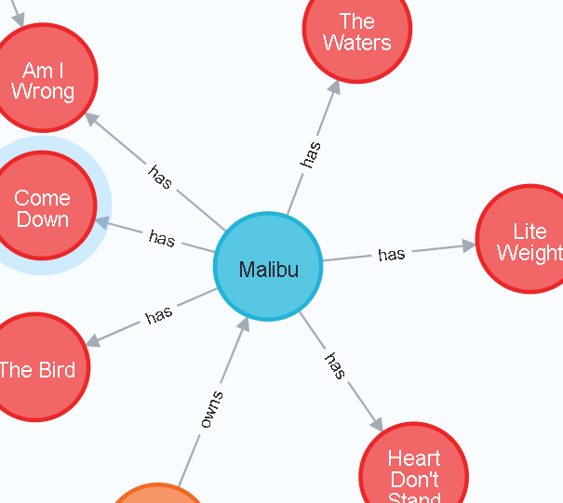
4. Create relation with song and album

Slide 6
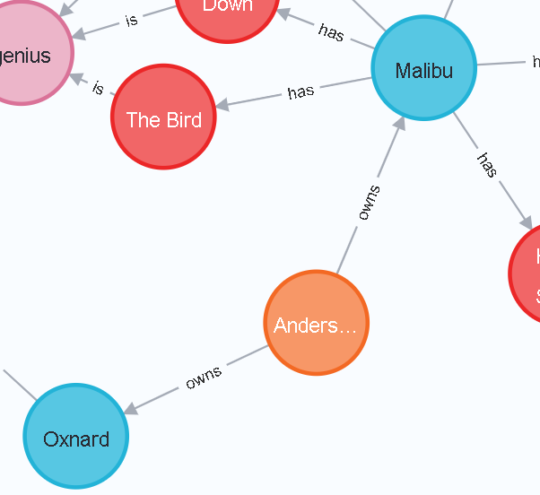
5. Create relation with album and artist
Example:
match(t:Album{name:"Malibu"}) match(s:Song) where s.album = "Malibu" create (t)-[ r:has]->(s)

Slide 7
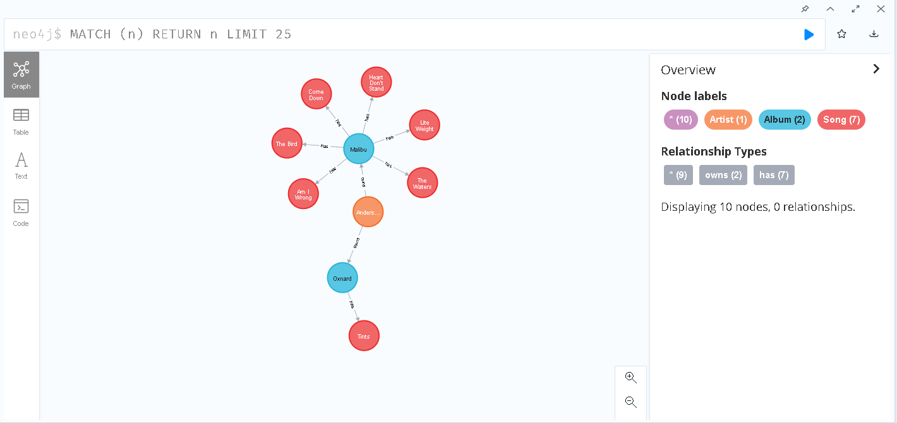
Overview: after importing josn file of songs

Slide 8
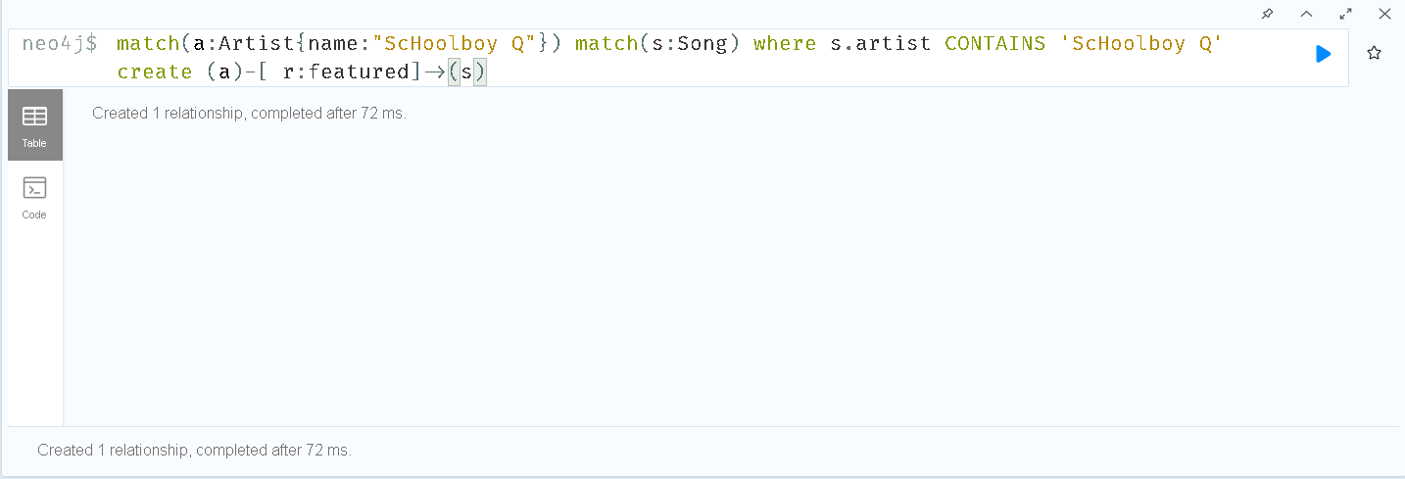
ADD featured artist and relation to song

Slide 9
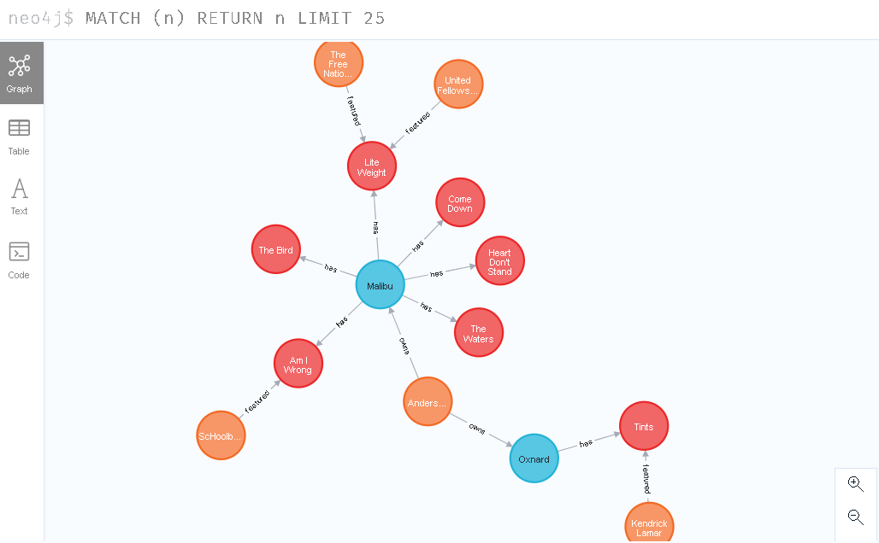
Overview

Slide 10
Importing and using hits charts from genius

Slide 11
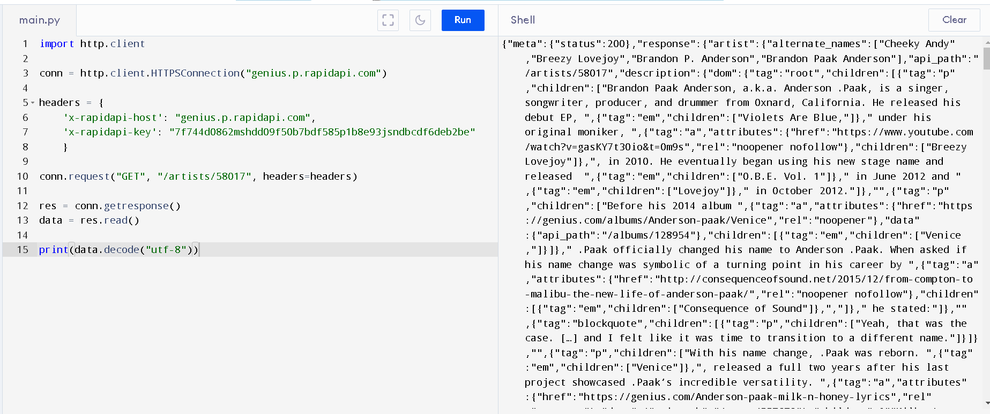
1. Get json file from genius

Slide 12
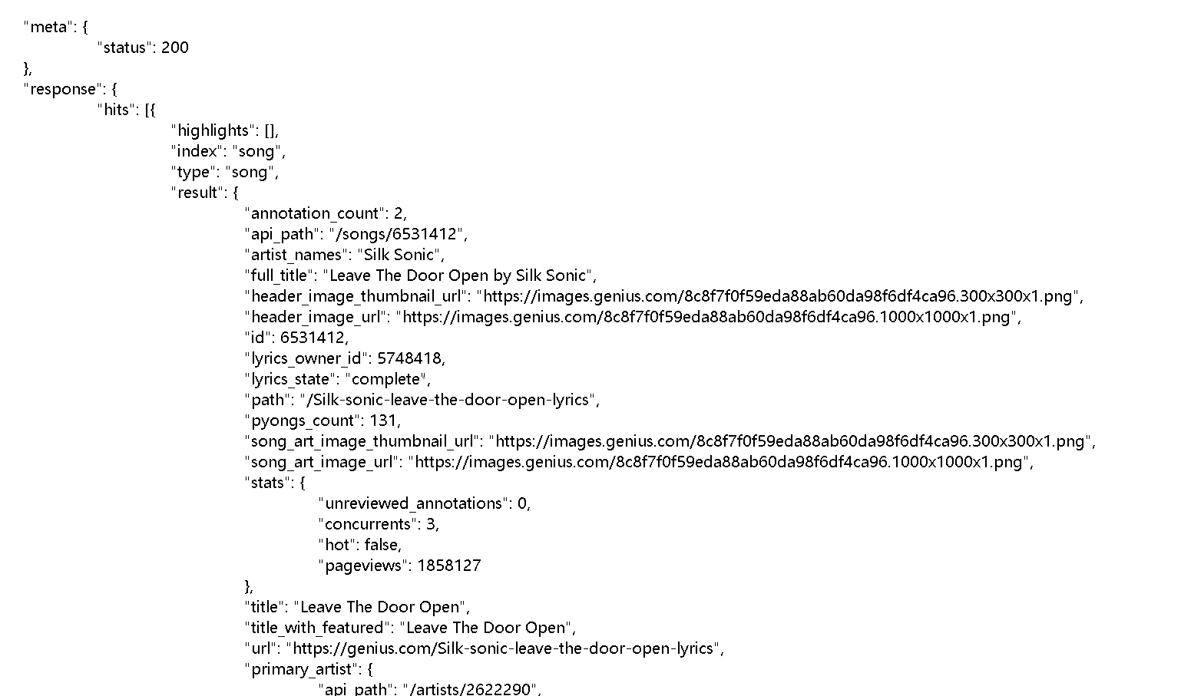

Slide 13

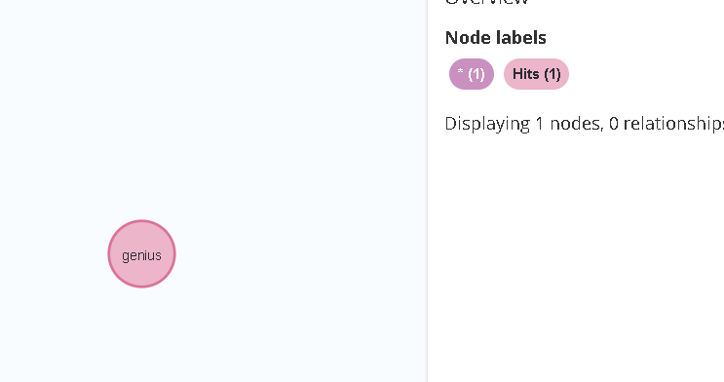
2. Create node, hits

Slide 14
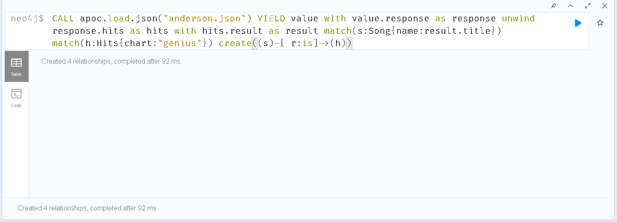
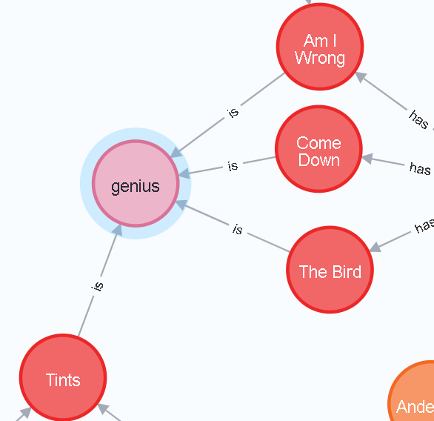
3. Create relation with hits and song

Slide 15
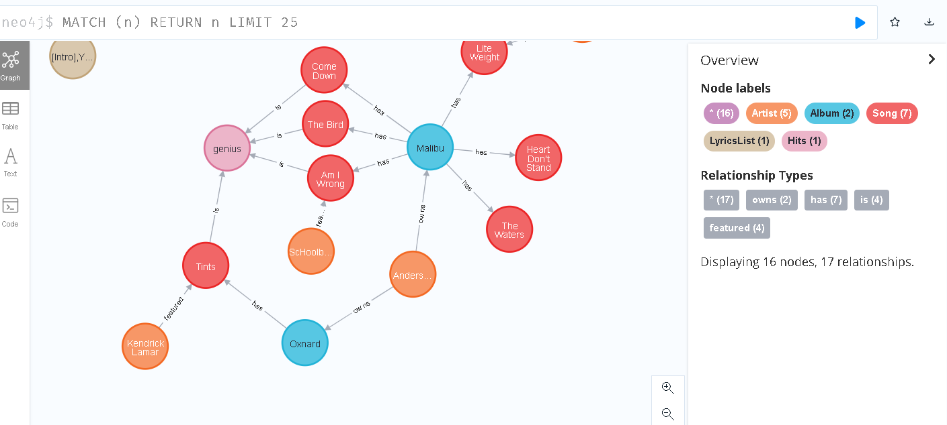
Overview

Slide 16
Example queries

Slide 17
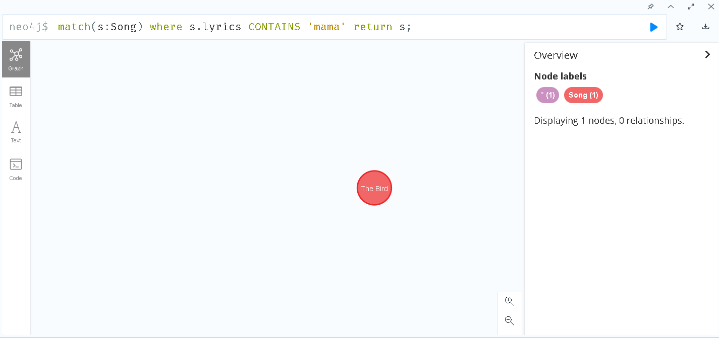
Search song which lyrics contain certain word

Slide 18
Word frequency for artist, Anderson .Paak

Slide 19
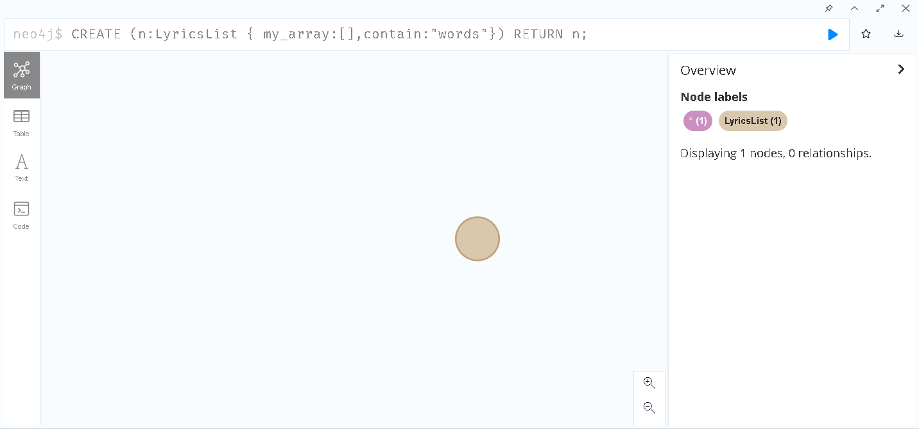
1. Create a lyricslist node with a array attribute

Slide 20
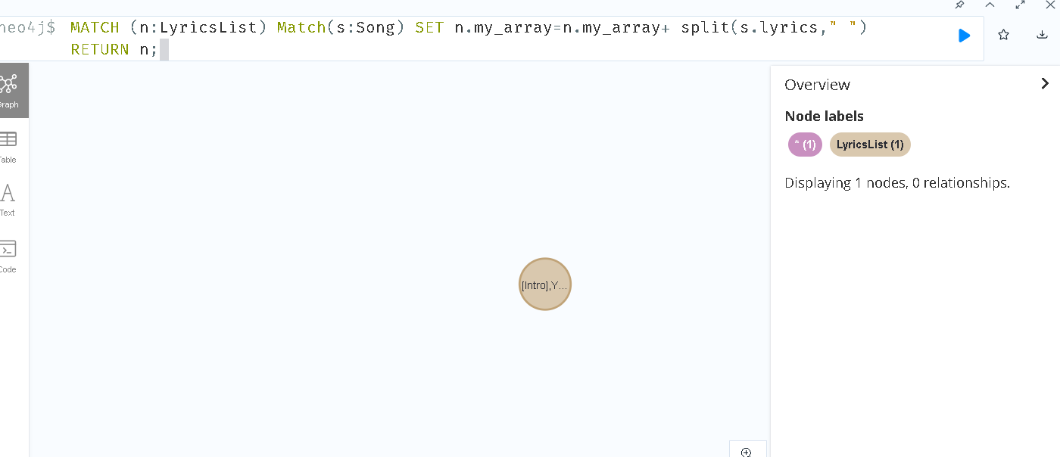
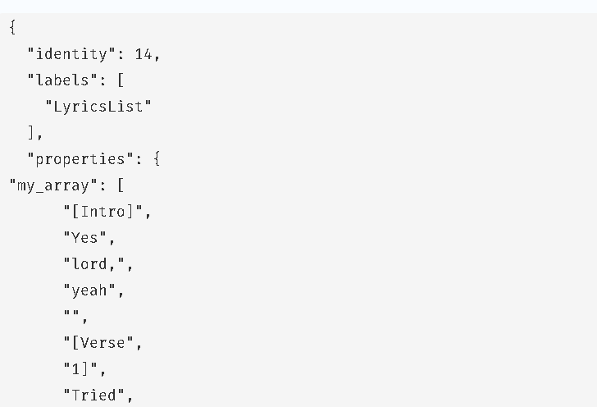
2. Store all the words from every songs in the array

Slide 21
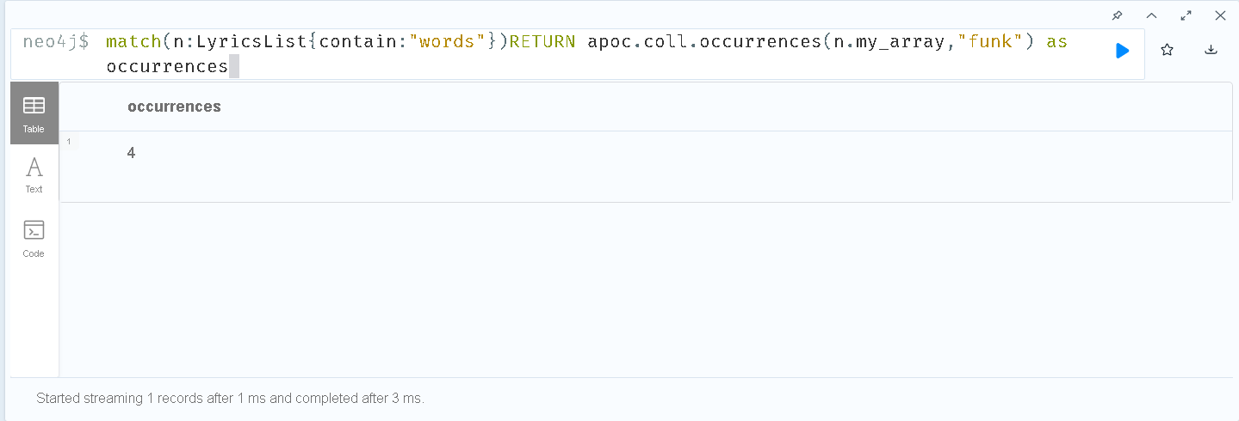
3. How many times does Anderson .Paak used the word, “funk”

Slide 22
How many verse or chorus does a song have?

Slide 23
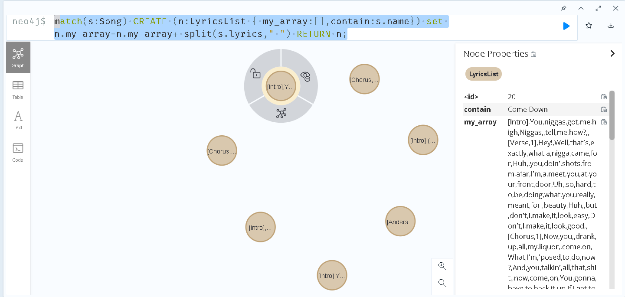
1. Create a lyricslist node for each song with every words in a array

Slide 24
2. Add verse and chorus counter to song
Example:
match(s:Song) set s.chorus = 0
match(s:Song) set s.verse = 0

Slide 25
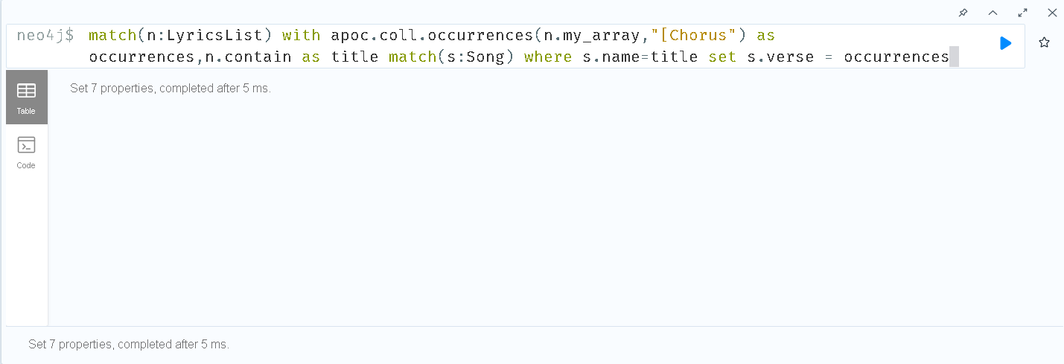
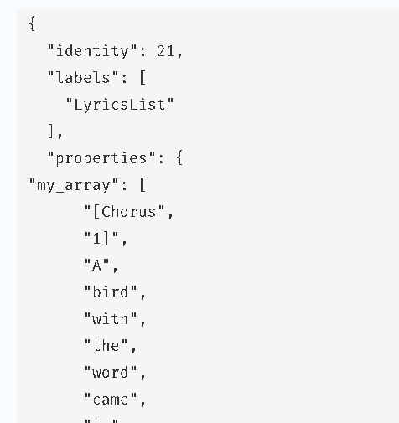
3. Count for chorus and verse

Slide 26
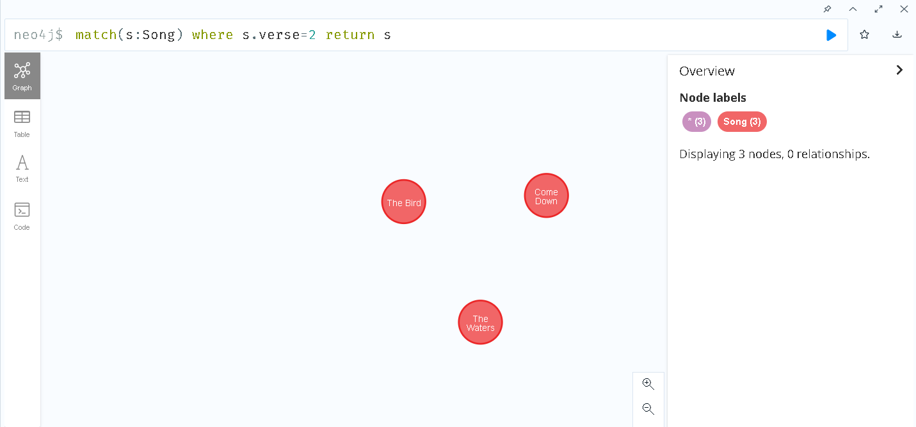
4. What are the song with 2 verses

Slide 27
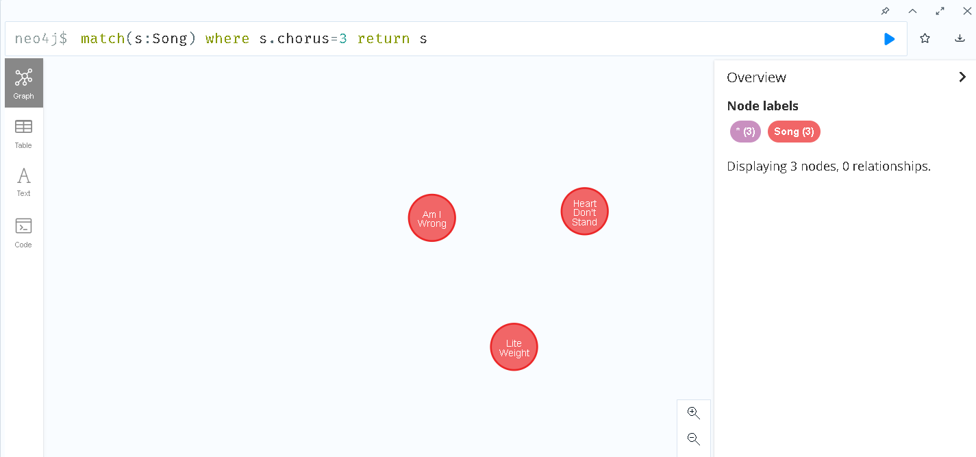
5. What are the song with 3 chorus

Slide 28
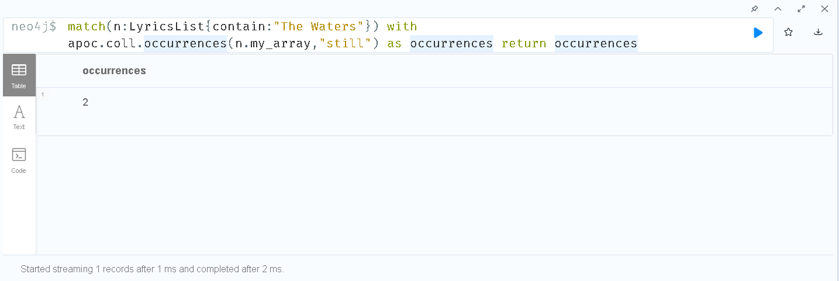
Word counting within a song

Slide 29
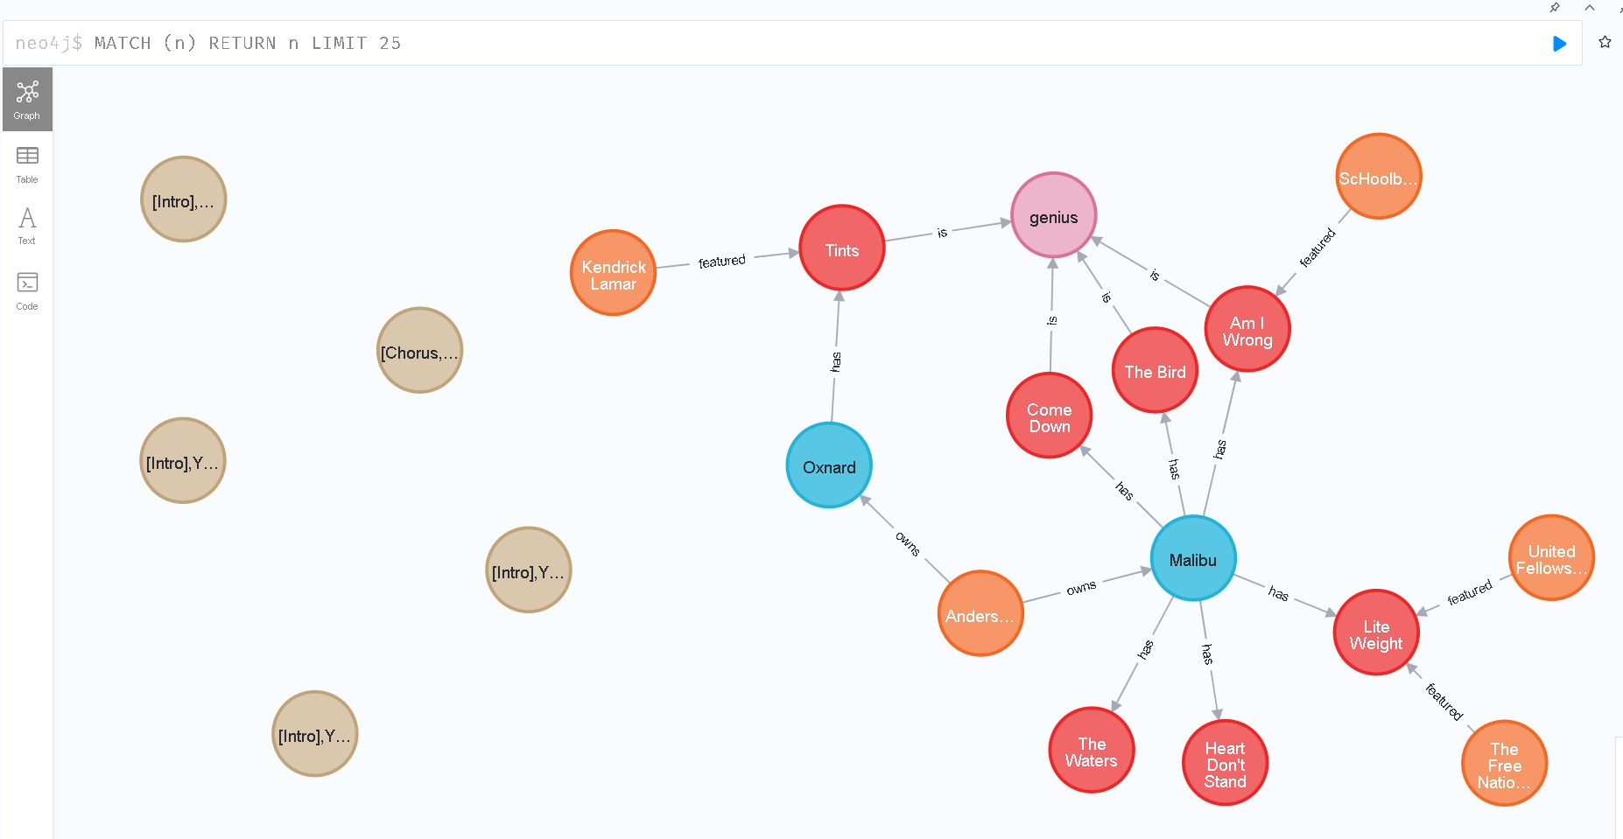
Final overview

